Slide 1
DATE - 12 th February
DAY- Monday
LOCATION- DCTE Auditorium

Slide 2
. Under the joint aegis of Deepshikha Art Institute and University of Technology, Student Recognition Award Ceremony program was organized at Nirmal Surana Auditorium on Monday in which world famous orthopedic surgeon Dr. Keshav Singhal, President of the institution Prem Surana, HC Ganeshiya, BK Sharma, KL Sharma was present. Prof. Singhal introduced the students to his journey from Rajasthan to UK and, while narrating his inspiring life experiences, encouraged them as to how they can achieve success in their lives. Dr. Rita Bisht, Director of Deepshikha College of Technical Education, Mansarovar, organizer of the program, said that this program is in the interest of the students.

Slide 3
Ceremonial Rituals

Slide 4
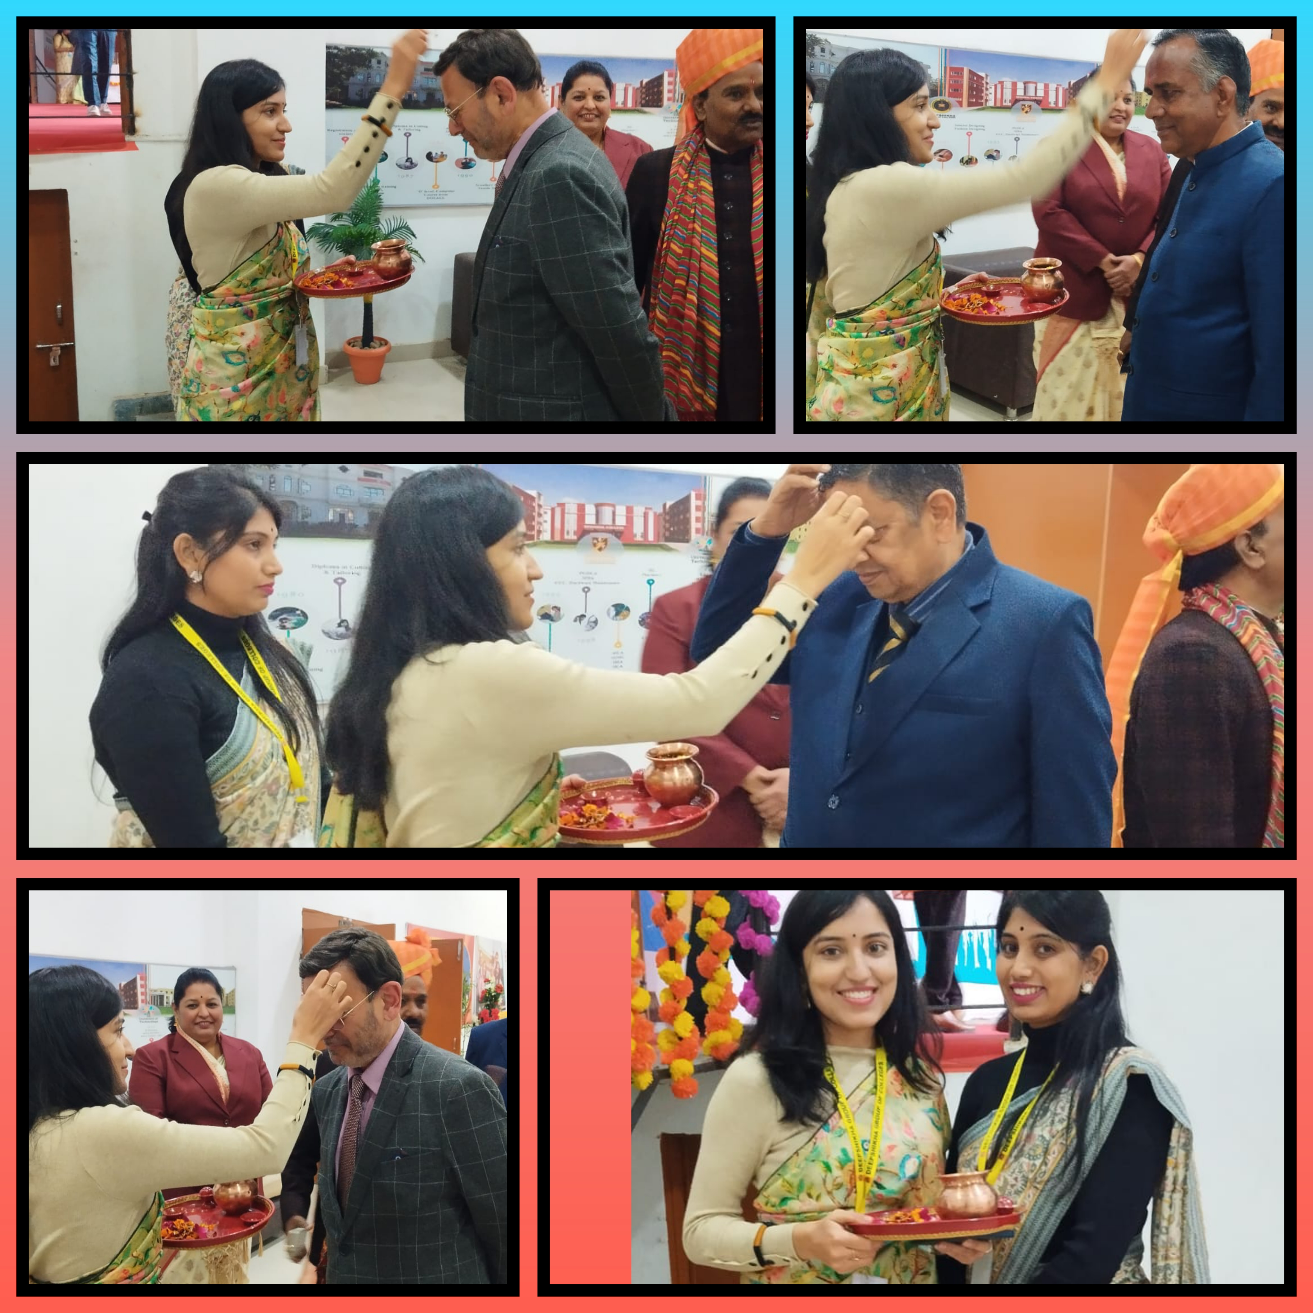
CEREMONIAL RITUALS

Slide 5
Ritual Of garlands To Maa Saraswati & Lamps Lighting

Slide 6
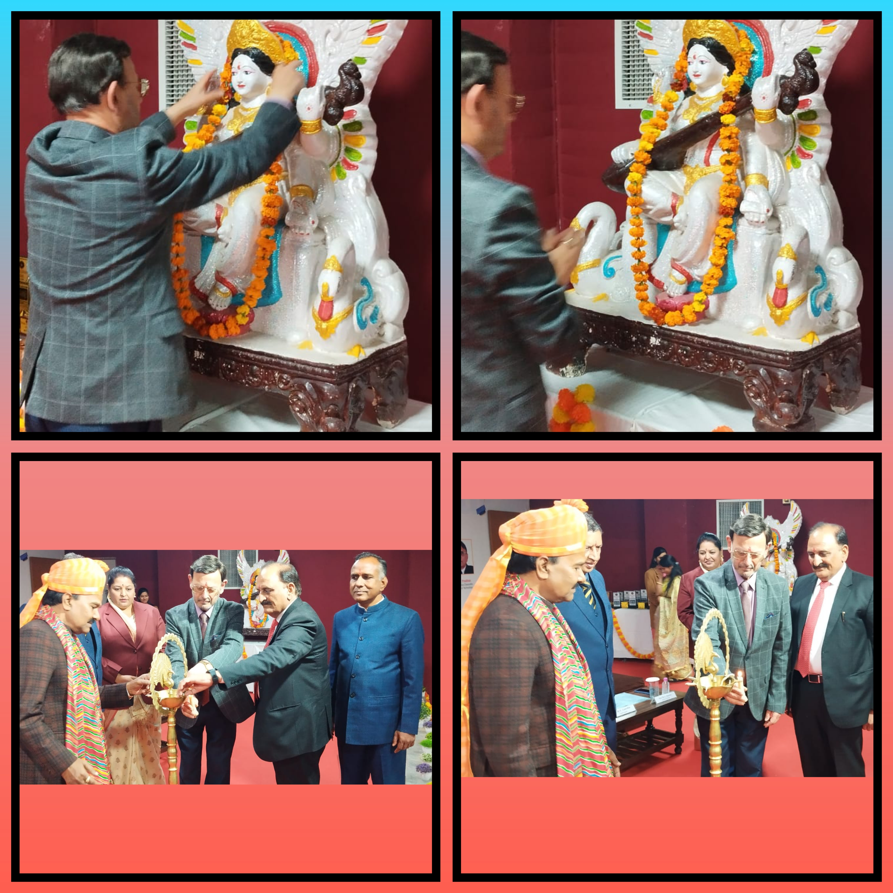

Slide 7
WELCOMING GESTURE

Slide 8
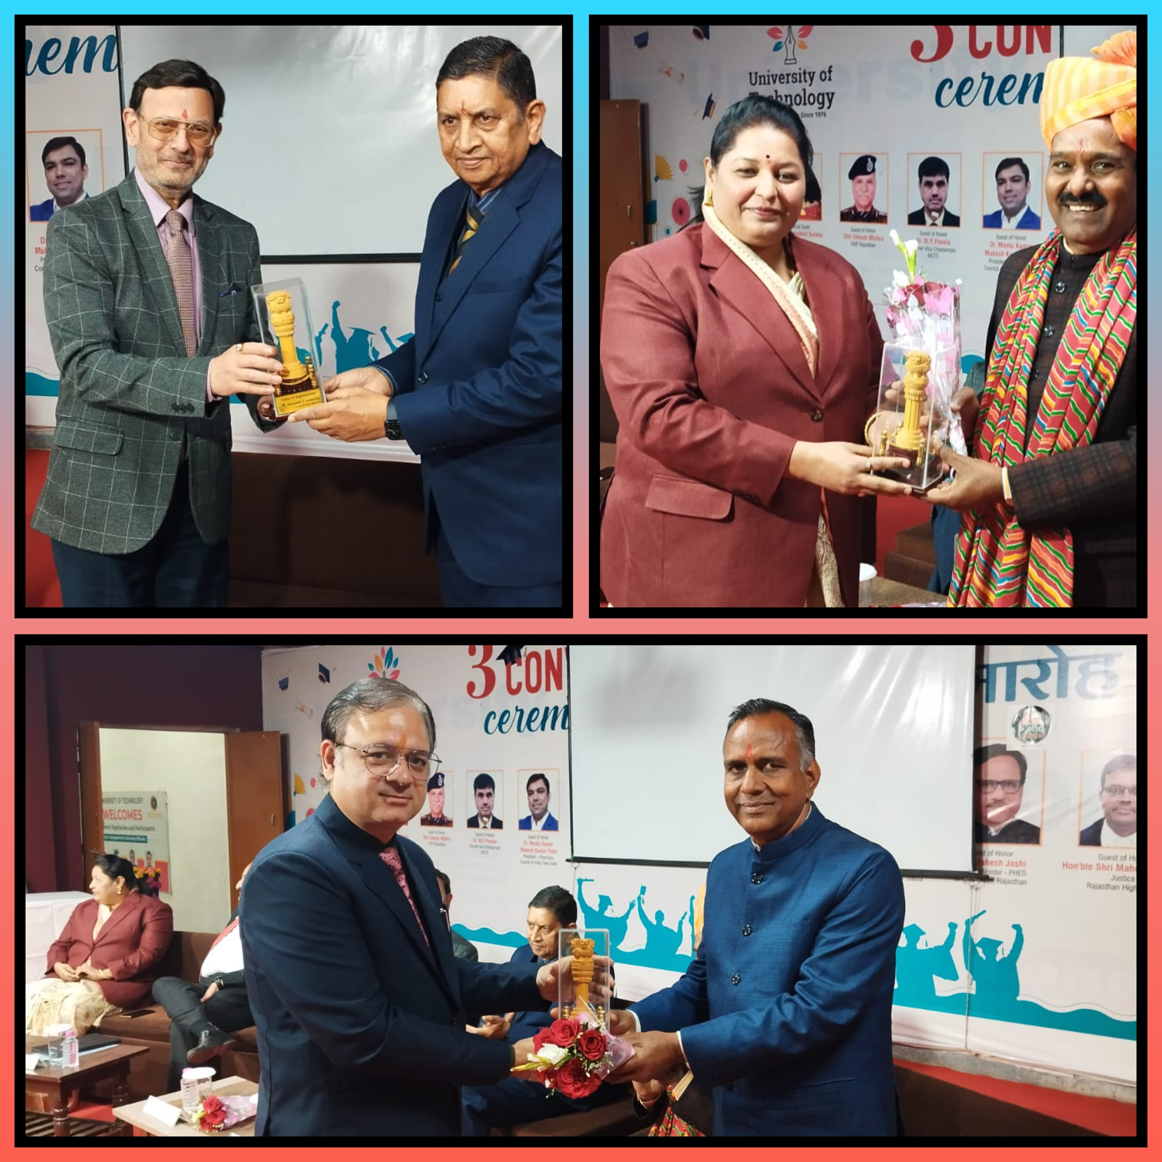

Slide 9
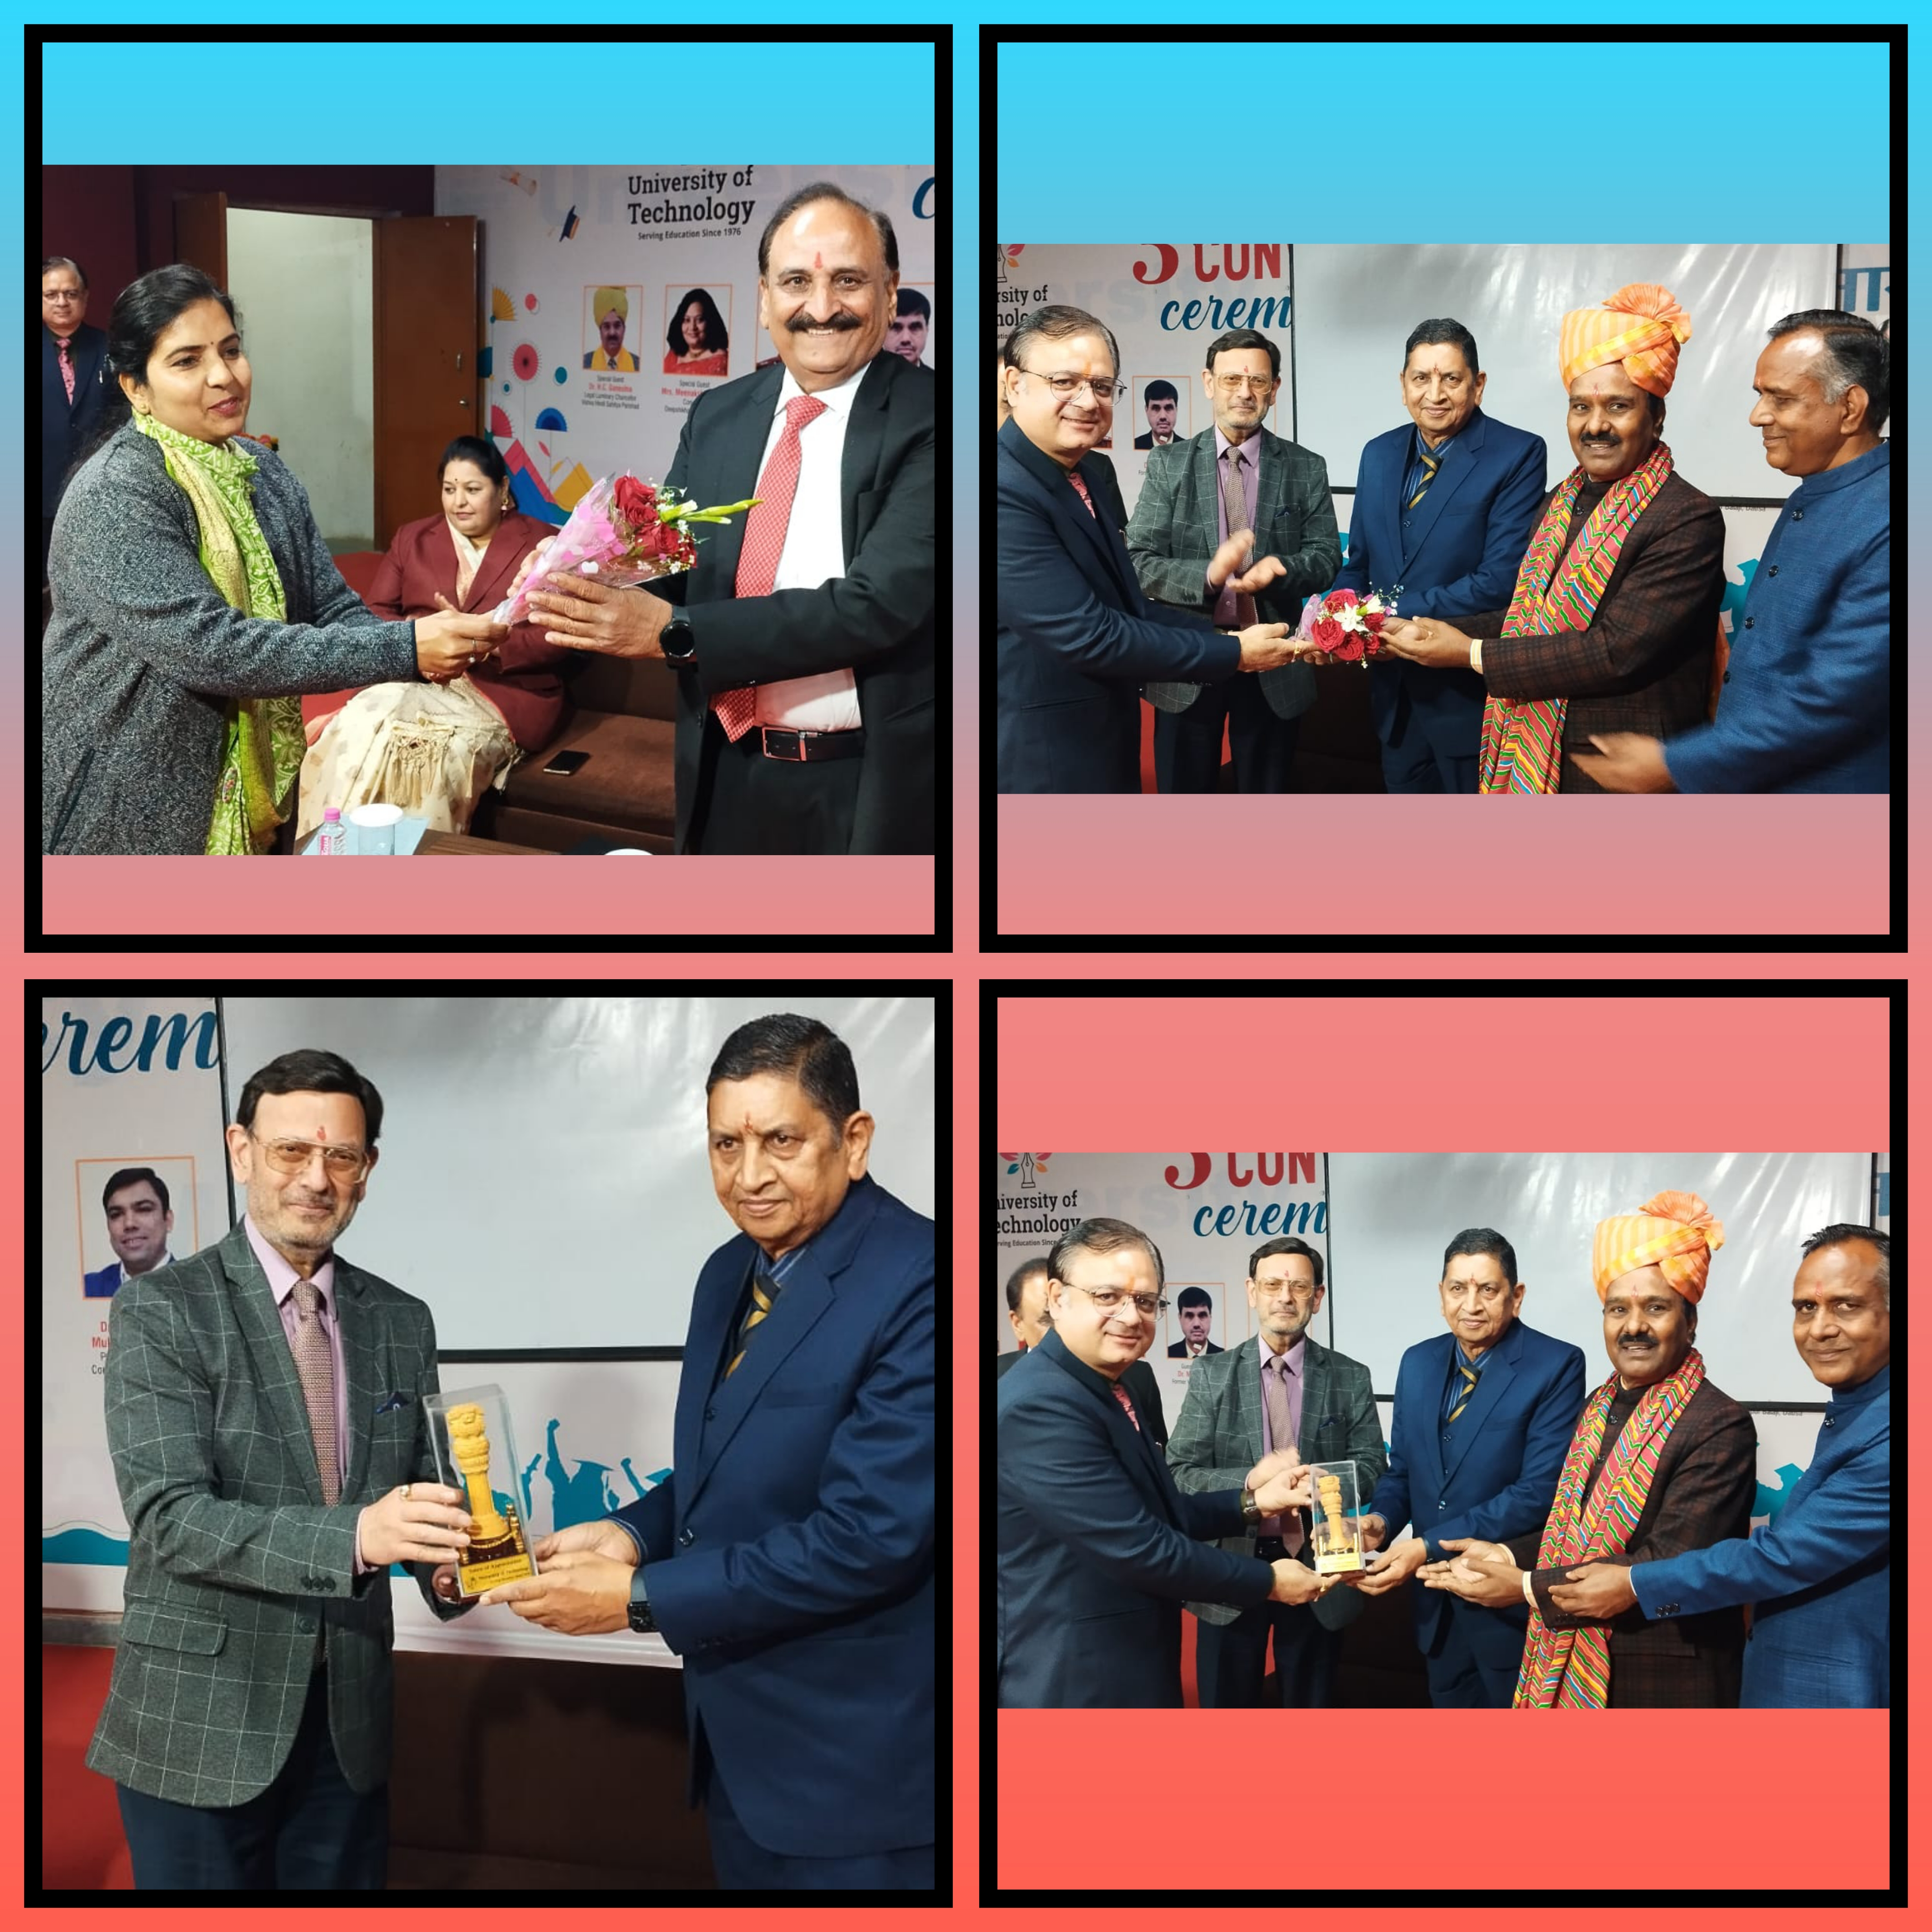

Slide 10
Student's Recoginition Award Distribution

Slide 11
In this program, the title of Student of the Year was given to B.Sc.Ed students Prakash Singh Rajpurohit and Tina Lalwani. Academic Excellence Award B. B. A. From Tanmay Saini, B.C.A. Cheshtha, B.A. From Sneha Gaur, B.Sc. From Tanisha Shamnani, In B.Sc.B.Ed.It was given to Anil Kumar Meena from the first year and Sudhanshu Vyas from the second year

Slide 12
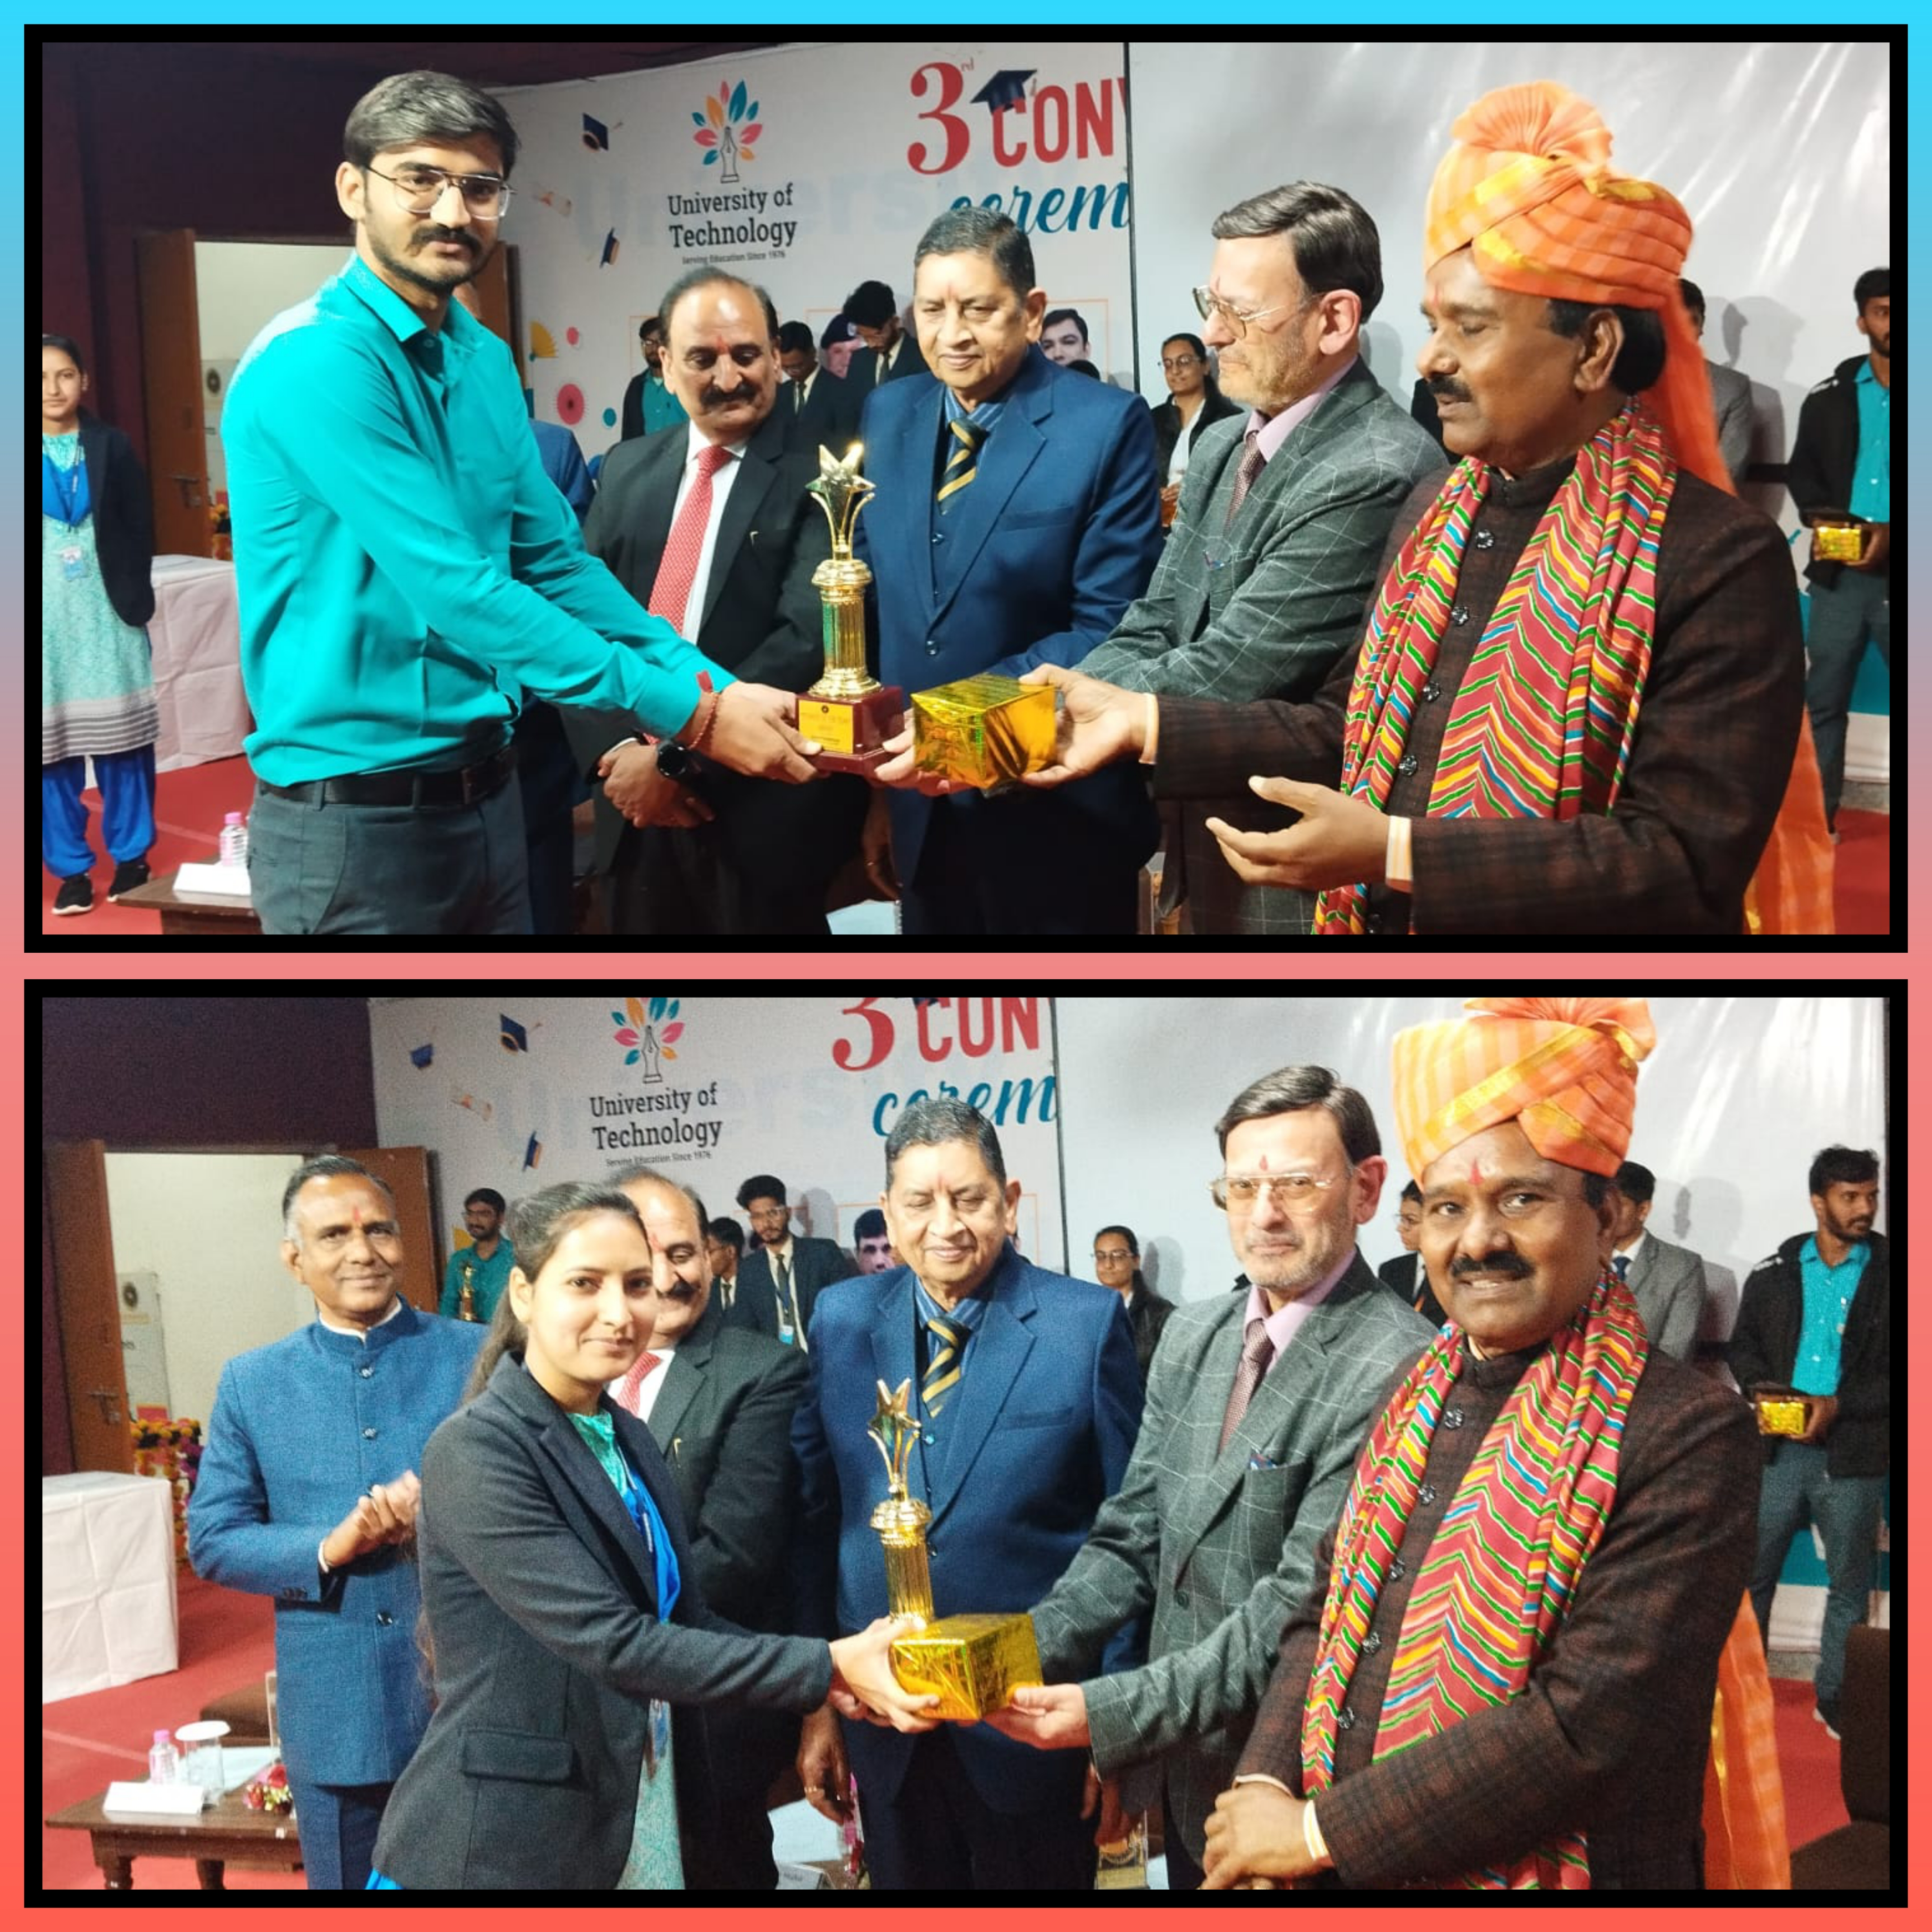

Slide 15
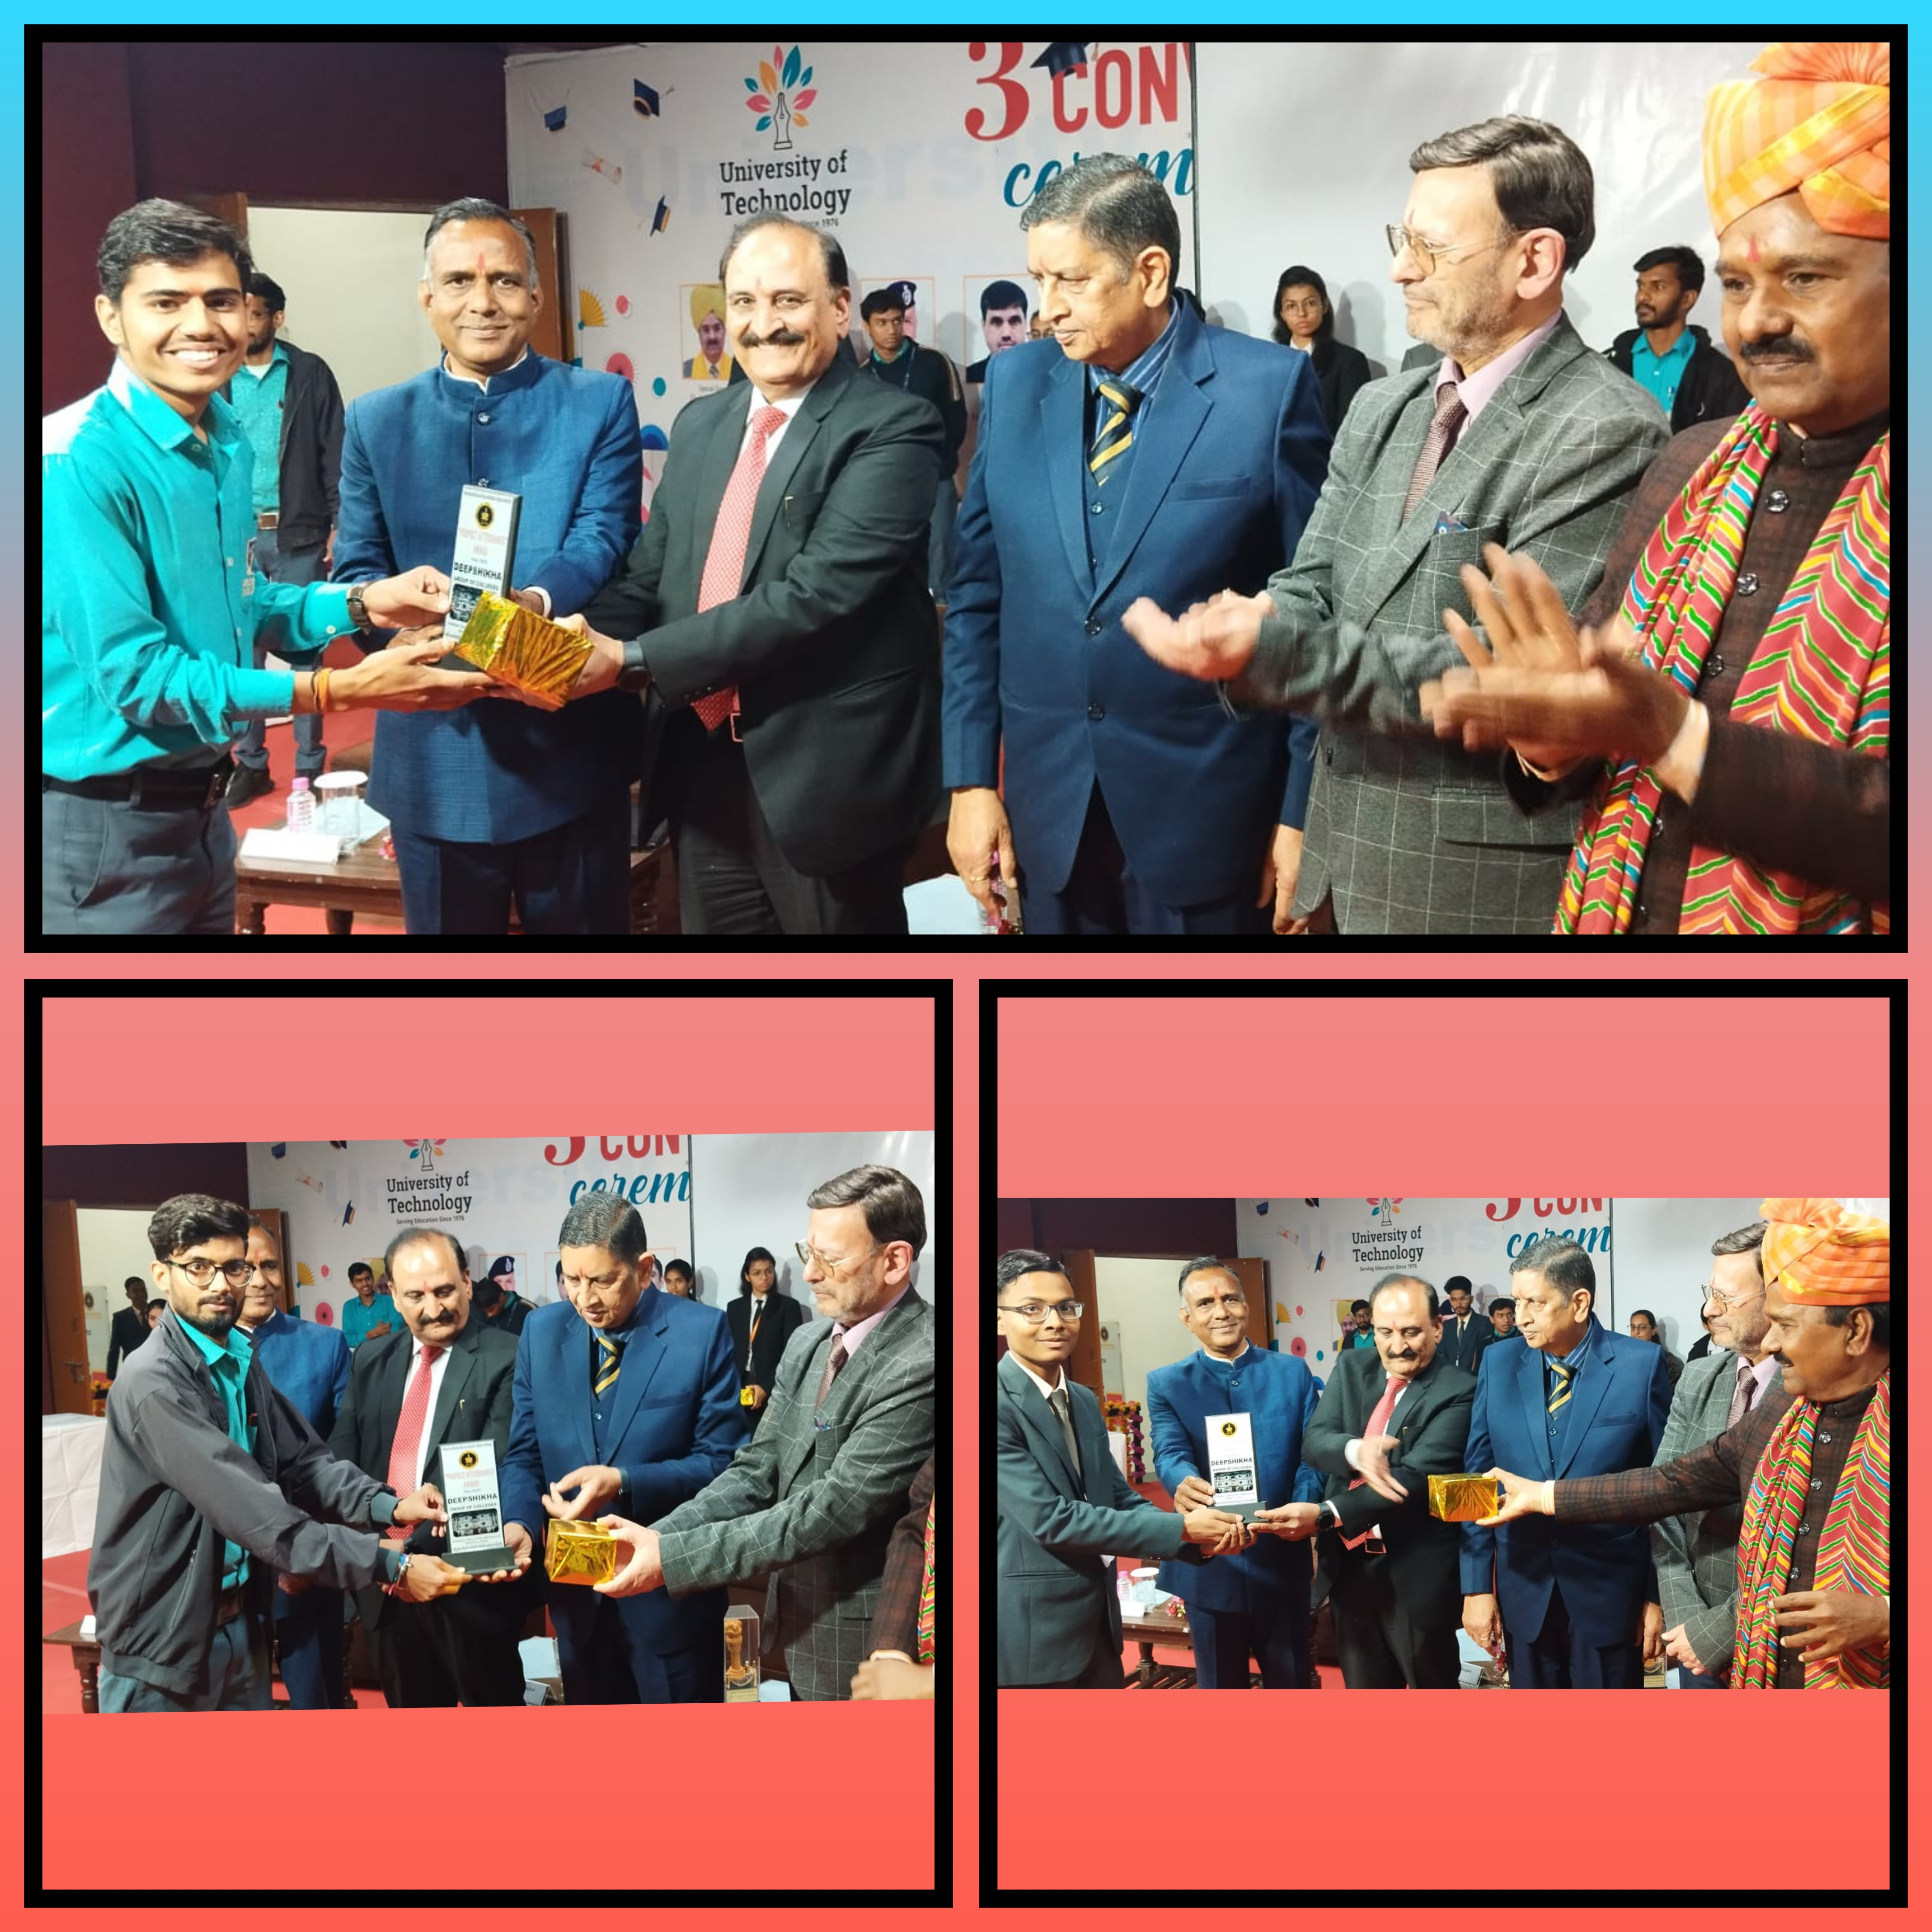

Slide 16
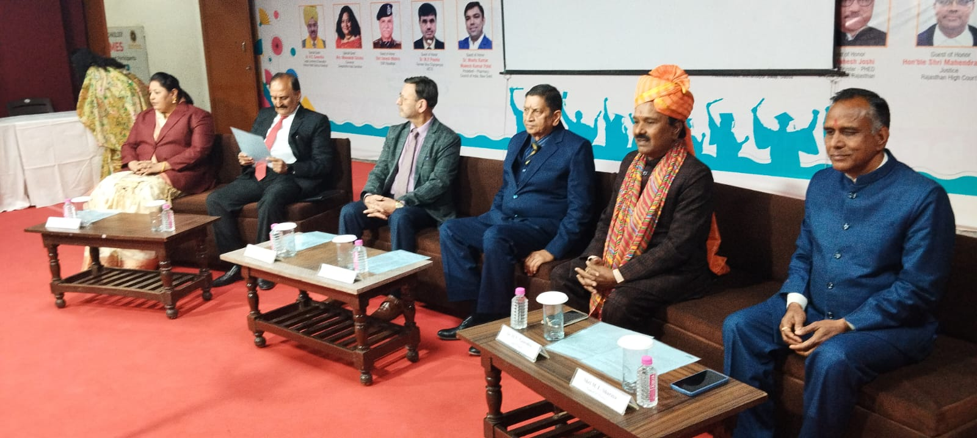

Slide 17
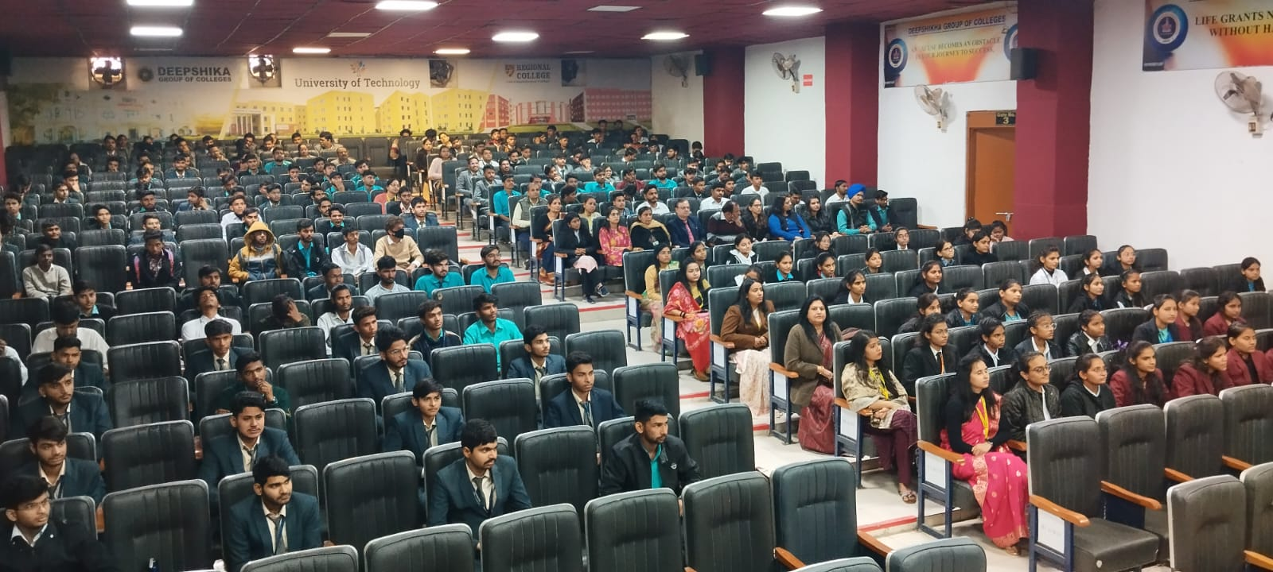

Slide 18
NEWS SECTION

Slide 20
Thank You

